Slide 1

SP CAFE CSQUARE PVT LTD

Slide 2

Company Profile
Concept CSQUARE was established in 2016, The concept is driven for getting the experience enrich in café and bar with diversity of cuisine under one roof.
CSquare which means c*c café and cocktail which gives the whole new experience as per your mood and serving their mouth watering food.
We have two concepts Csquare café and Csquare express both have different identity and their USPs.
Our cuisine is Indian, continental, Italian, Chinese, Mediterranean, Arabic, etc.
SP CAFE CSQUARE PVT LTD

Slide 3
Our USP
Wide Range of cuisines in options with authentic taste.
We customize
Corporate parties, social gathering, Kitty parties
at our venue.
We do not compromise on
quality and services
Our pricing > our quantity
=
Our ambience which gives
An experience and a feel
To be here.
Our few dishes like Khudhar muchiyan, Dau pasha, Mexican rice bowl etc are our USP
SP CAFE CSQUARE PVT LTD
.

Slide 4
Who we are
Csquare which stands for c*c i.e. coffee and cocktail. We work on the fundamentals of a place with 2 distinguish factors-
a. From morning till evening it’s a place to enjoy coffees, other beverages along with various dishes from our menu having a peace of country music to sooth your environment..
b. Post evening the café delivers a very happening atmosphere with liquors in house having the same menu with few add-ons to get the best of the experience for our clients.
We have 2 models for our clients and franchisee investors
Csquare café- A good number of cover café and with varied and distinct variety of cuisine. Generally adds a bit huge investment and caters to higher spending market.
Csquare Express- A kiosk with limited dishes and is in general caters to finger food and quick serving market, such as Corporate, busy market places and any other suitable shopping are
SP CAFE CSQUARE PVT LTD
.

Slide 5
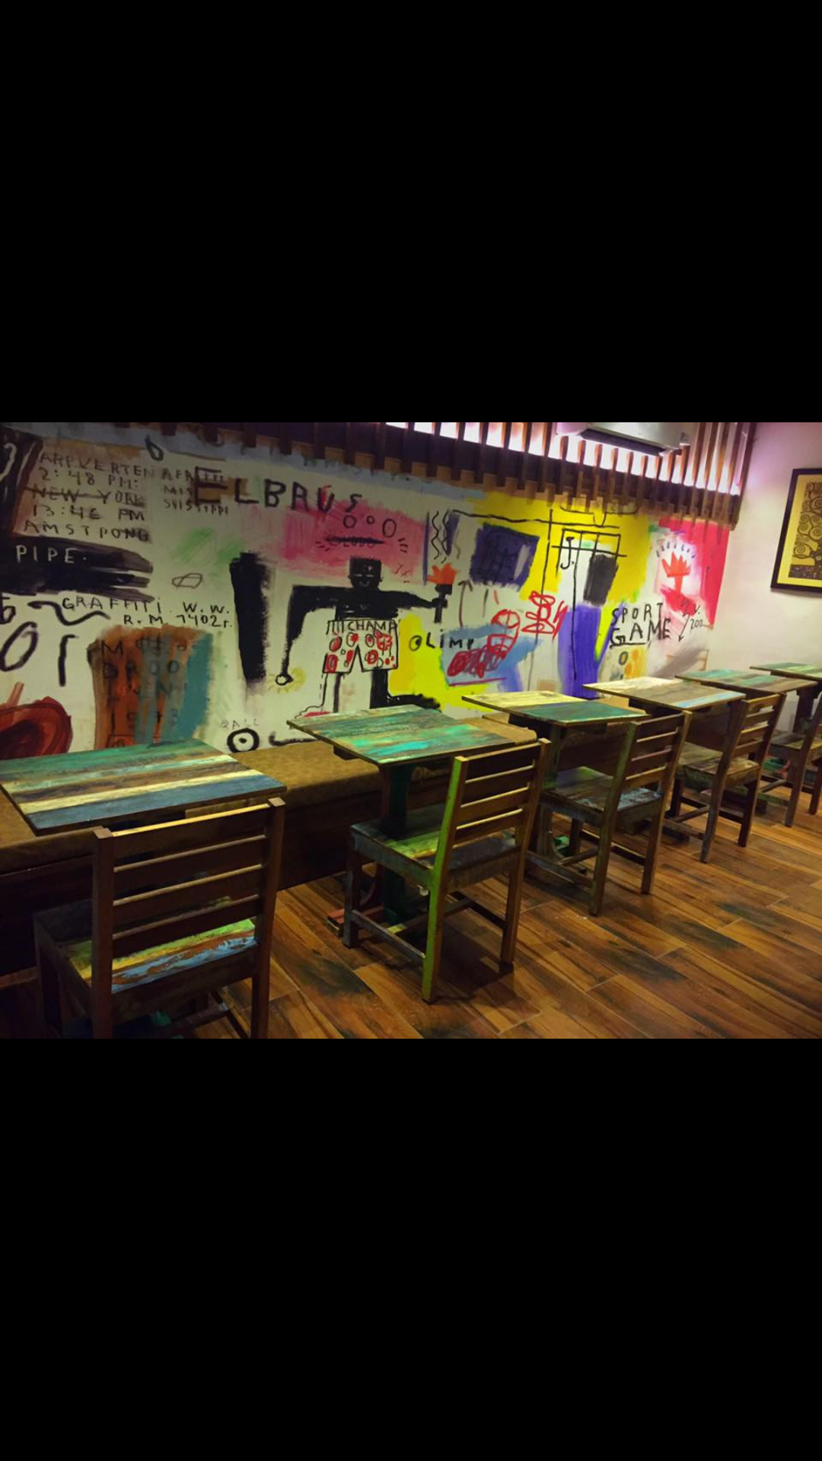
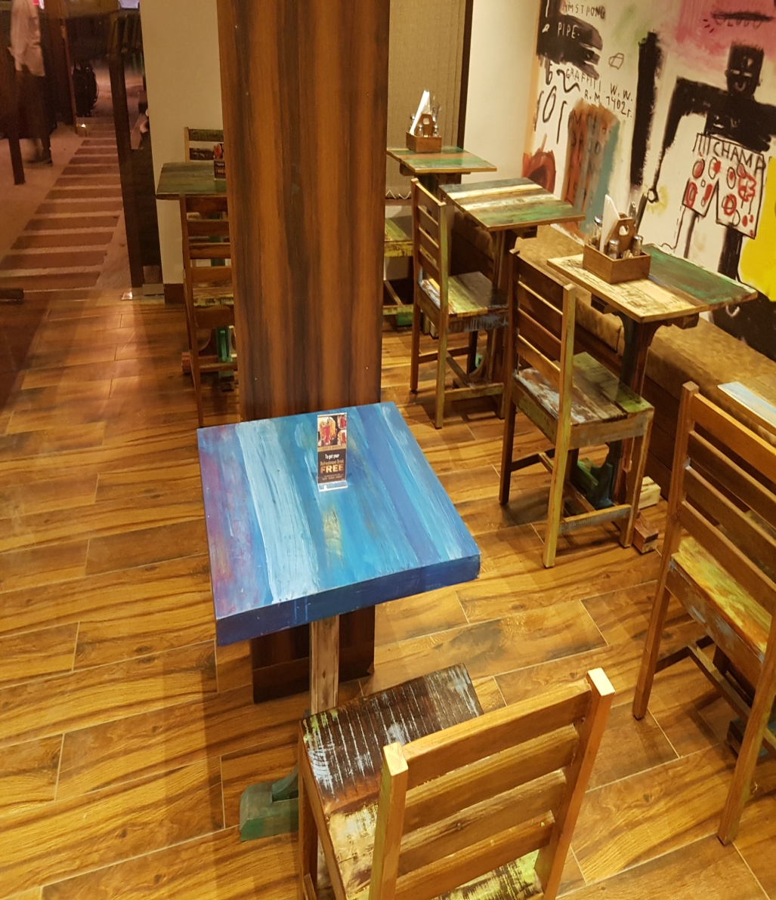
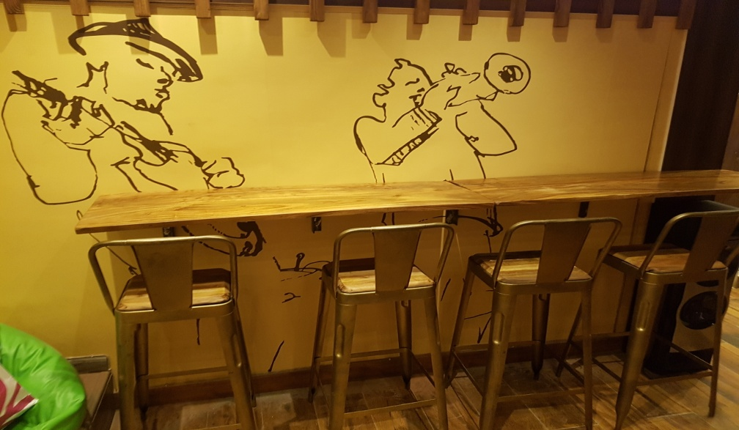
Our Retail Outlets
SP CAFE CSQUARE PVT LTD

Slide 6
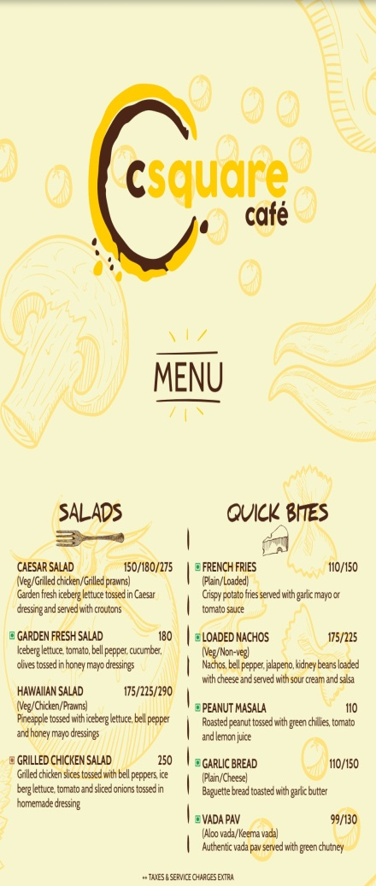
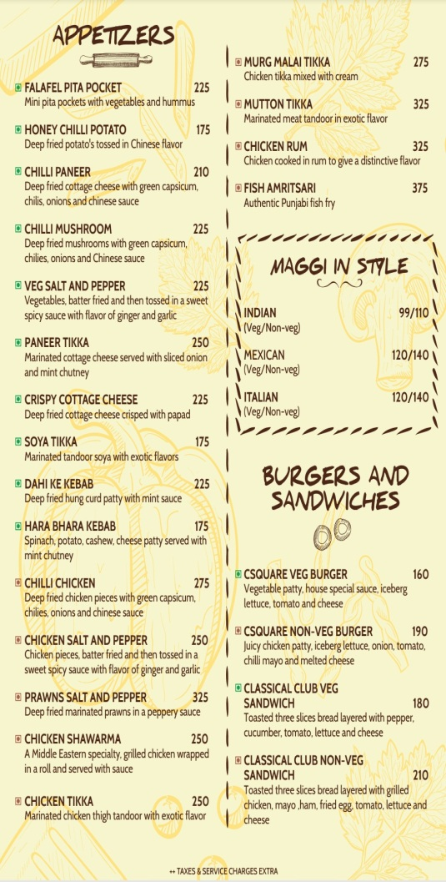
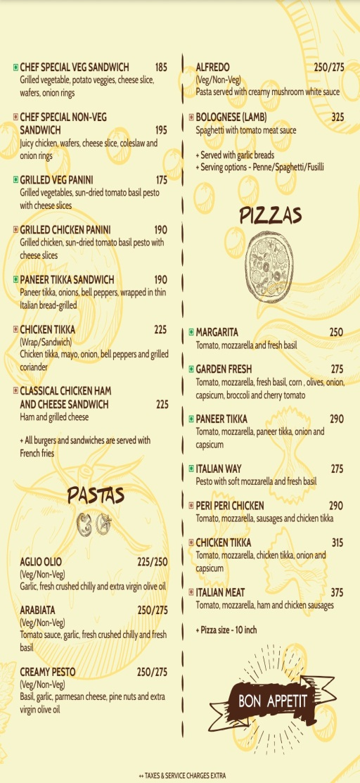
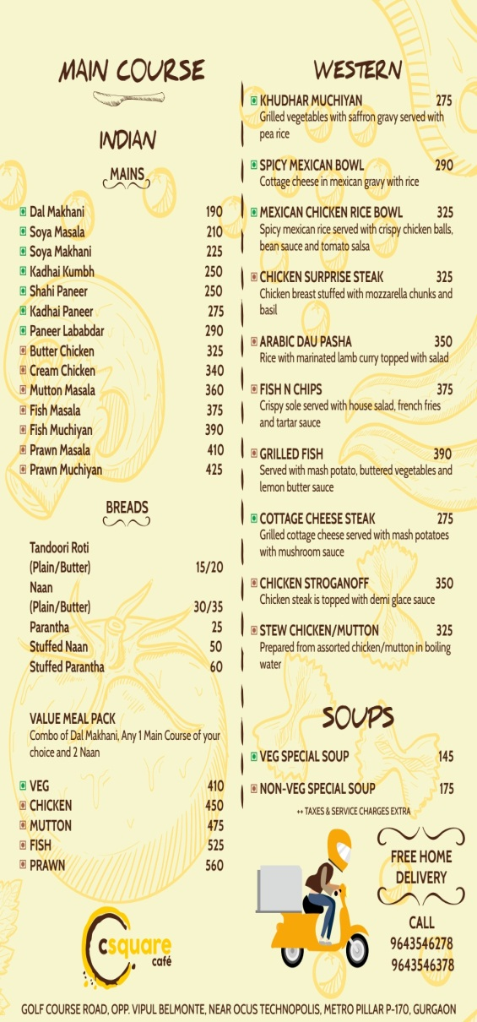
Our Menu
SP CAFE CSQUARE PVT LTD

Slide 7
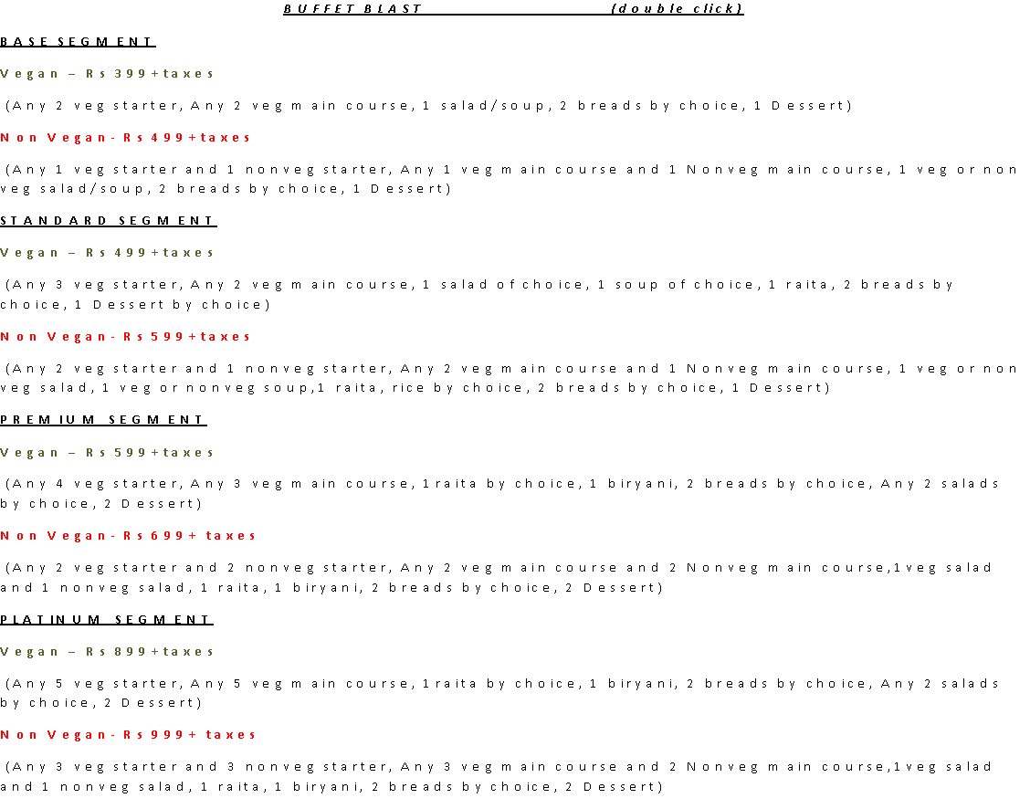

Slide 8
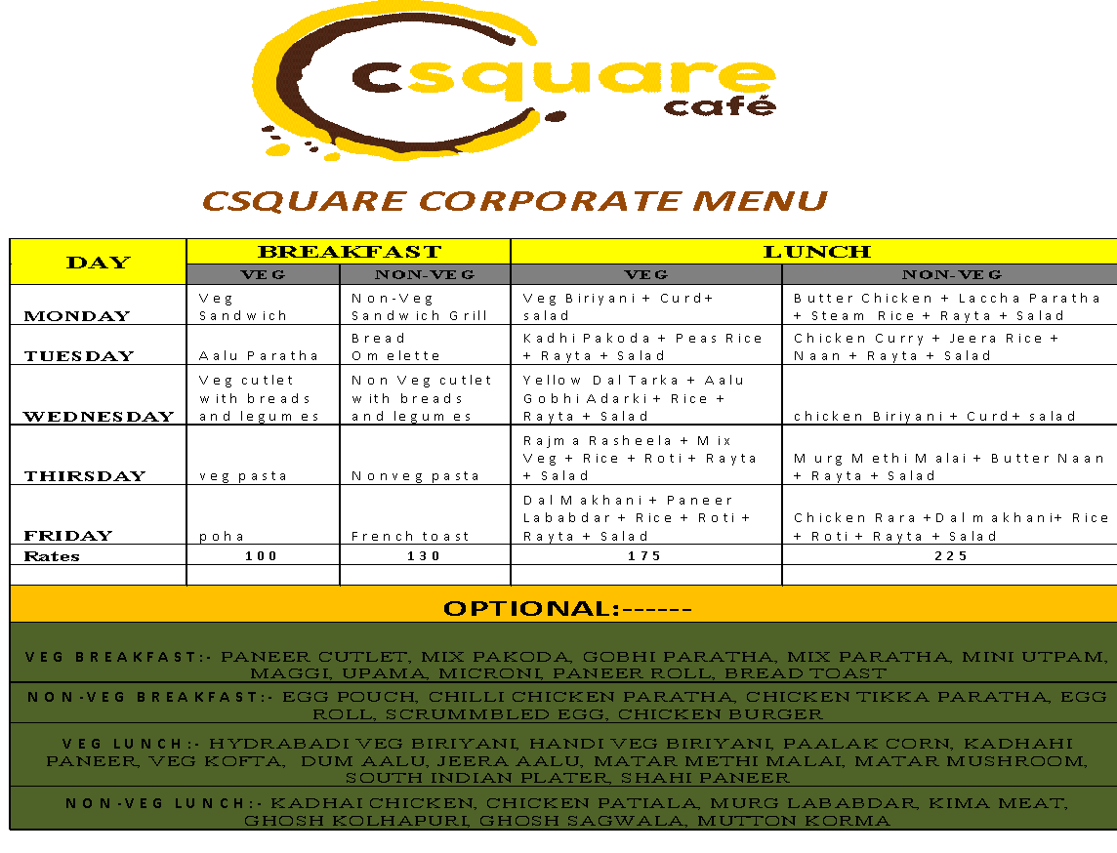

Slide 9
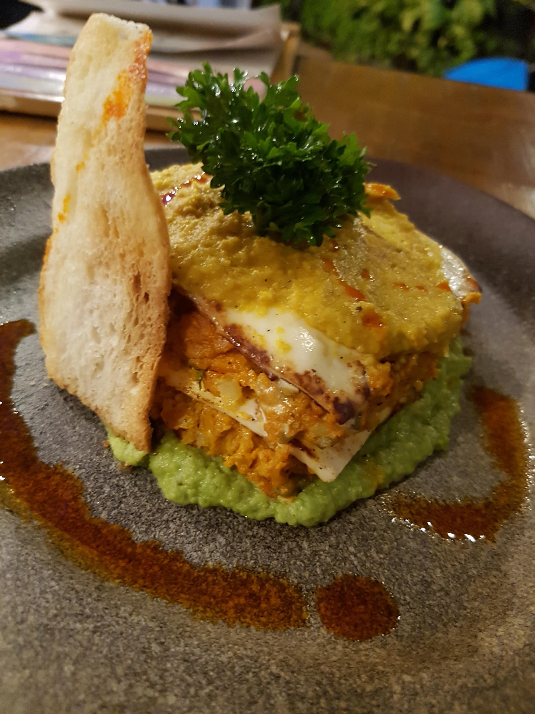
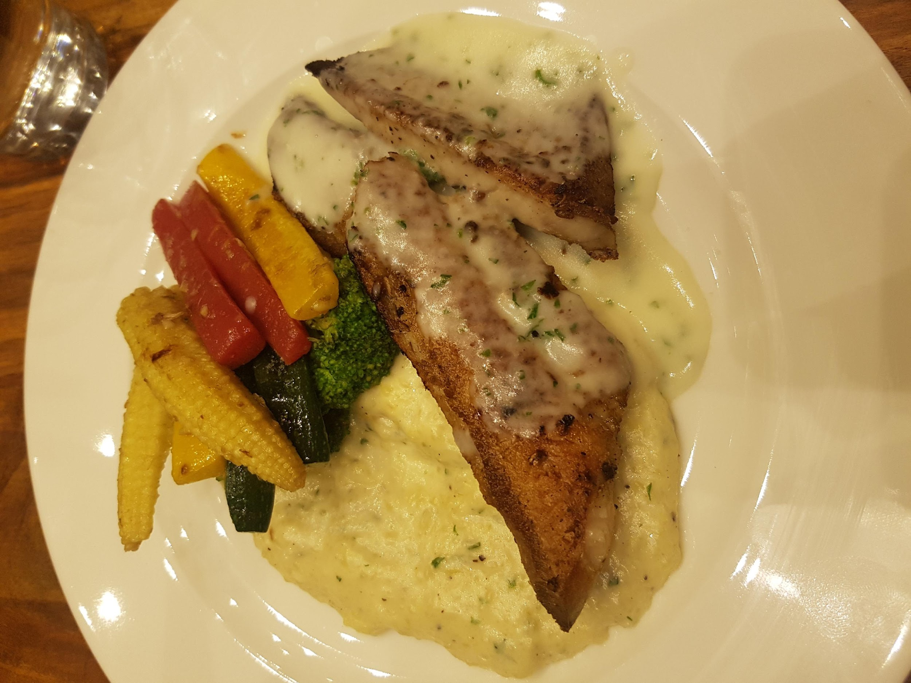
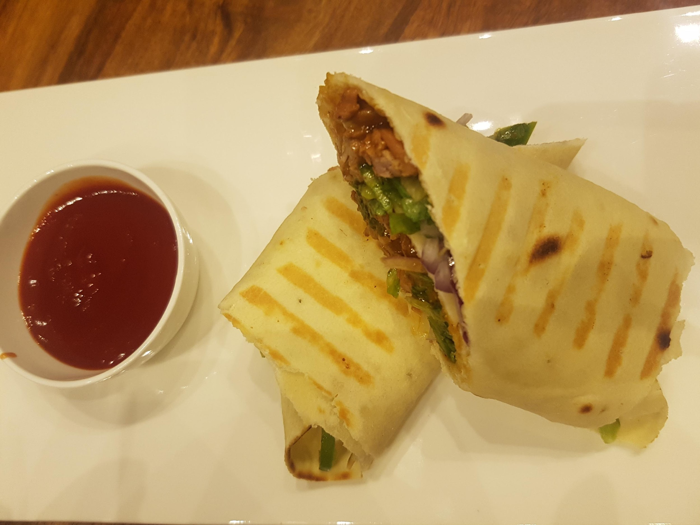
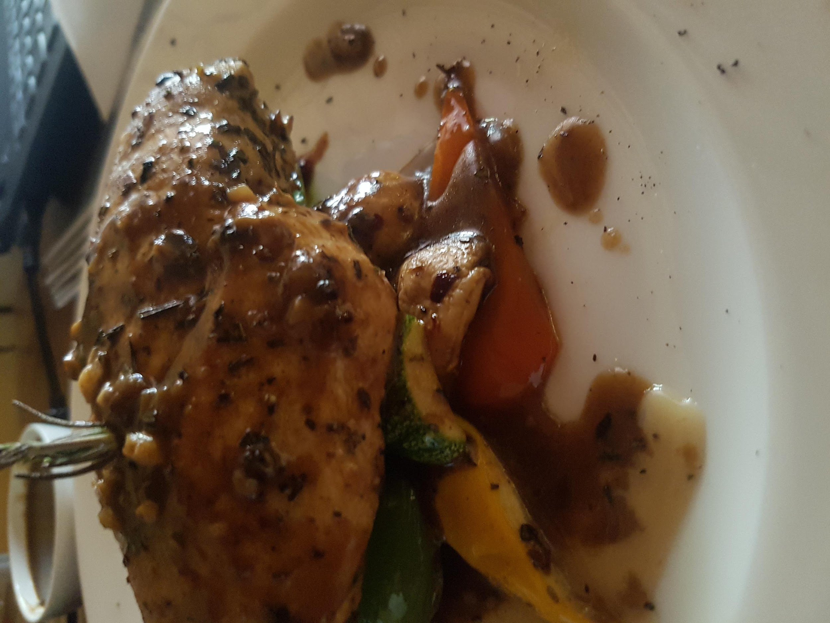
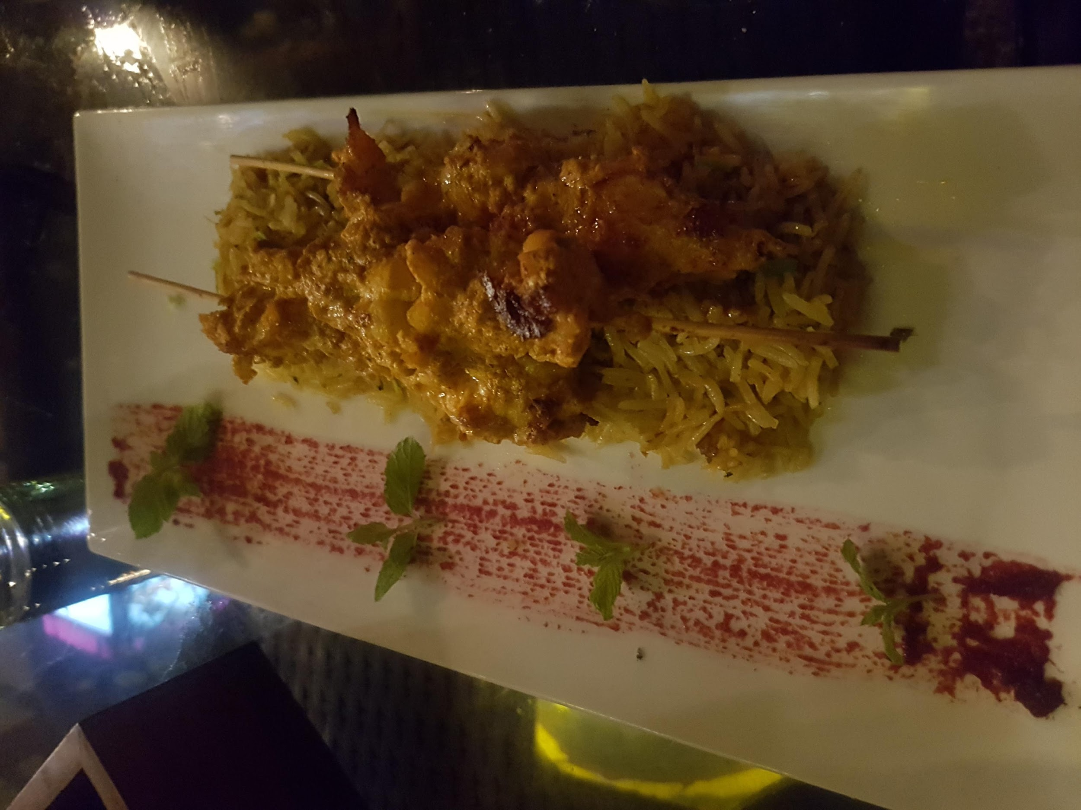
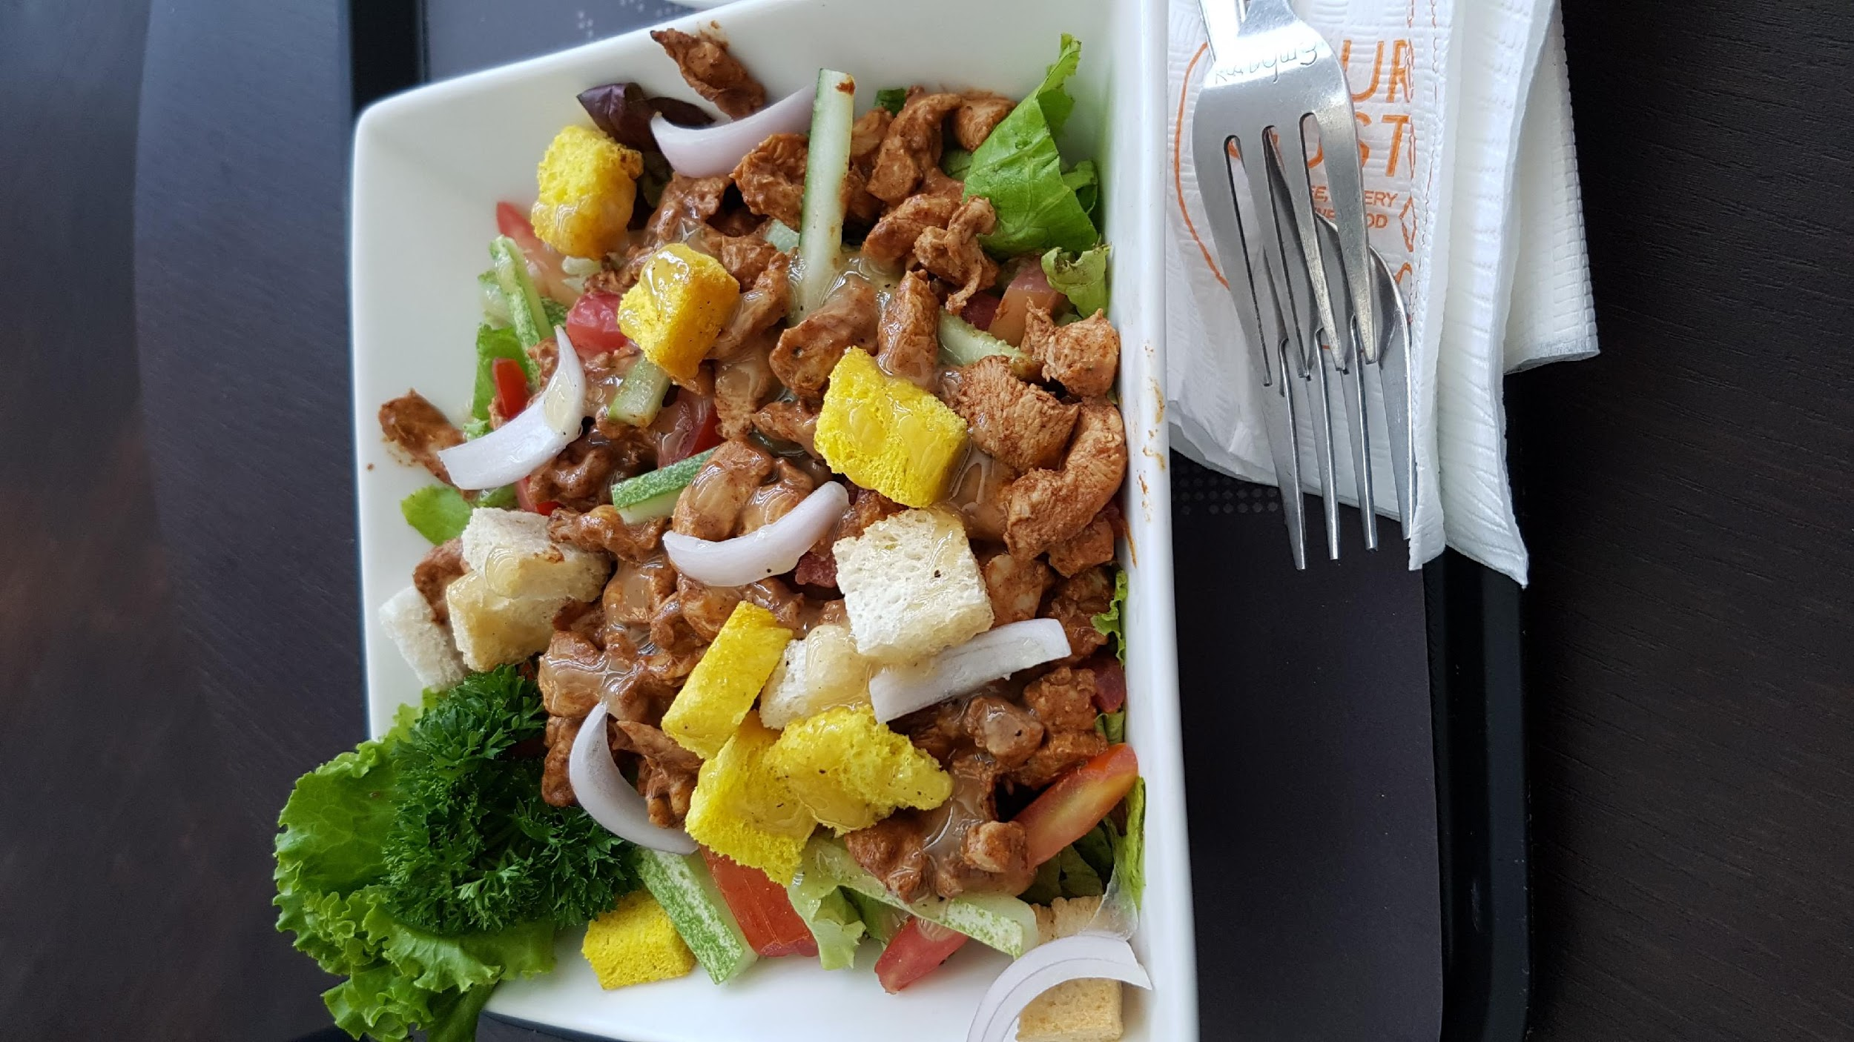
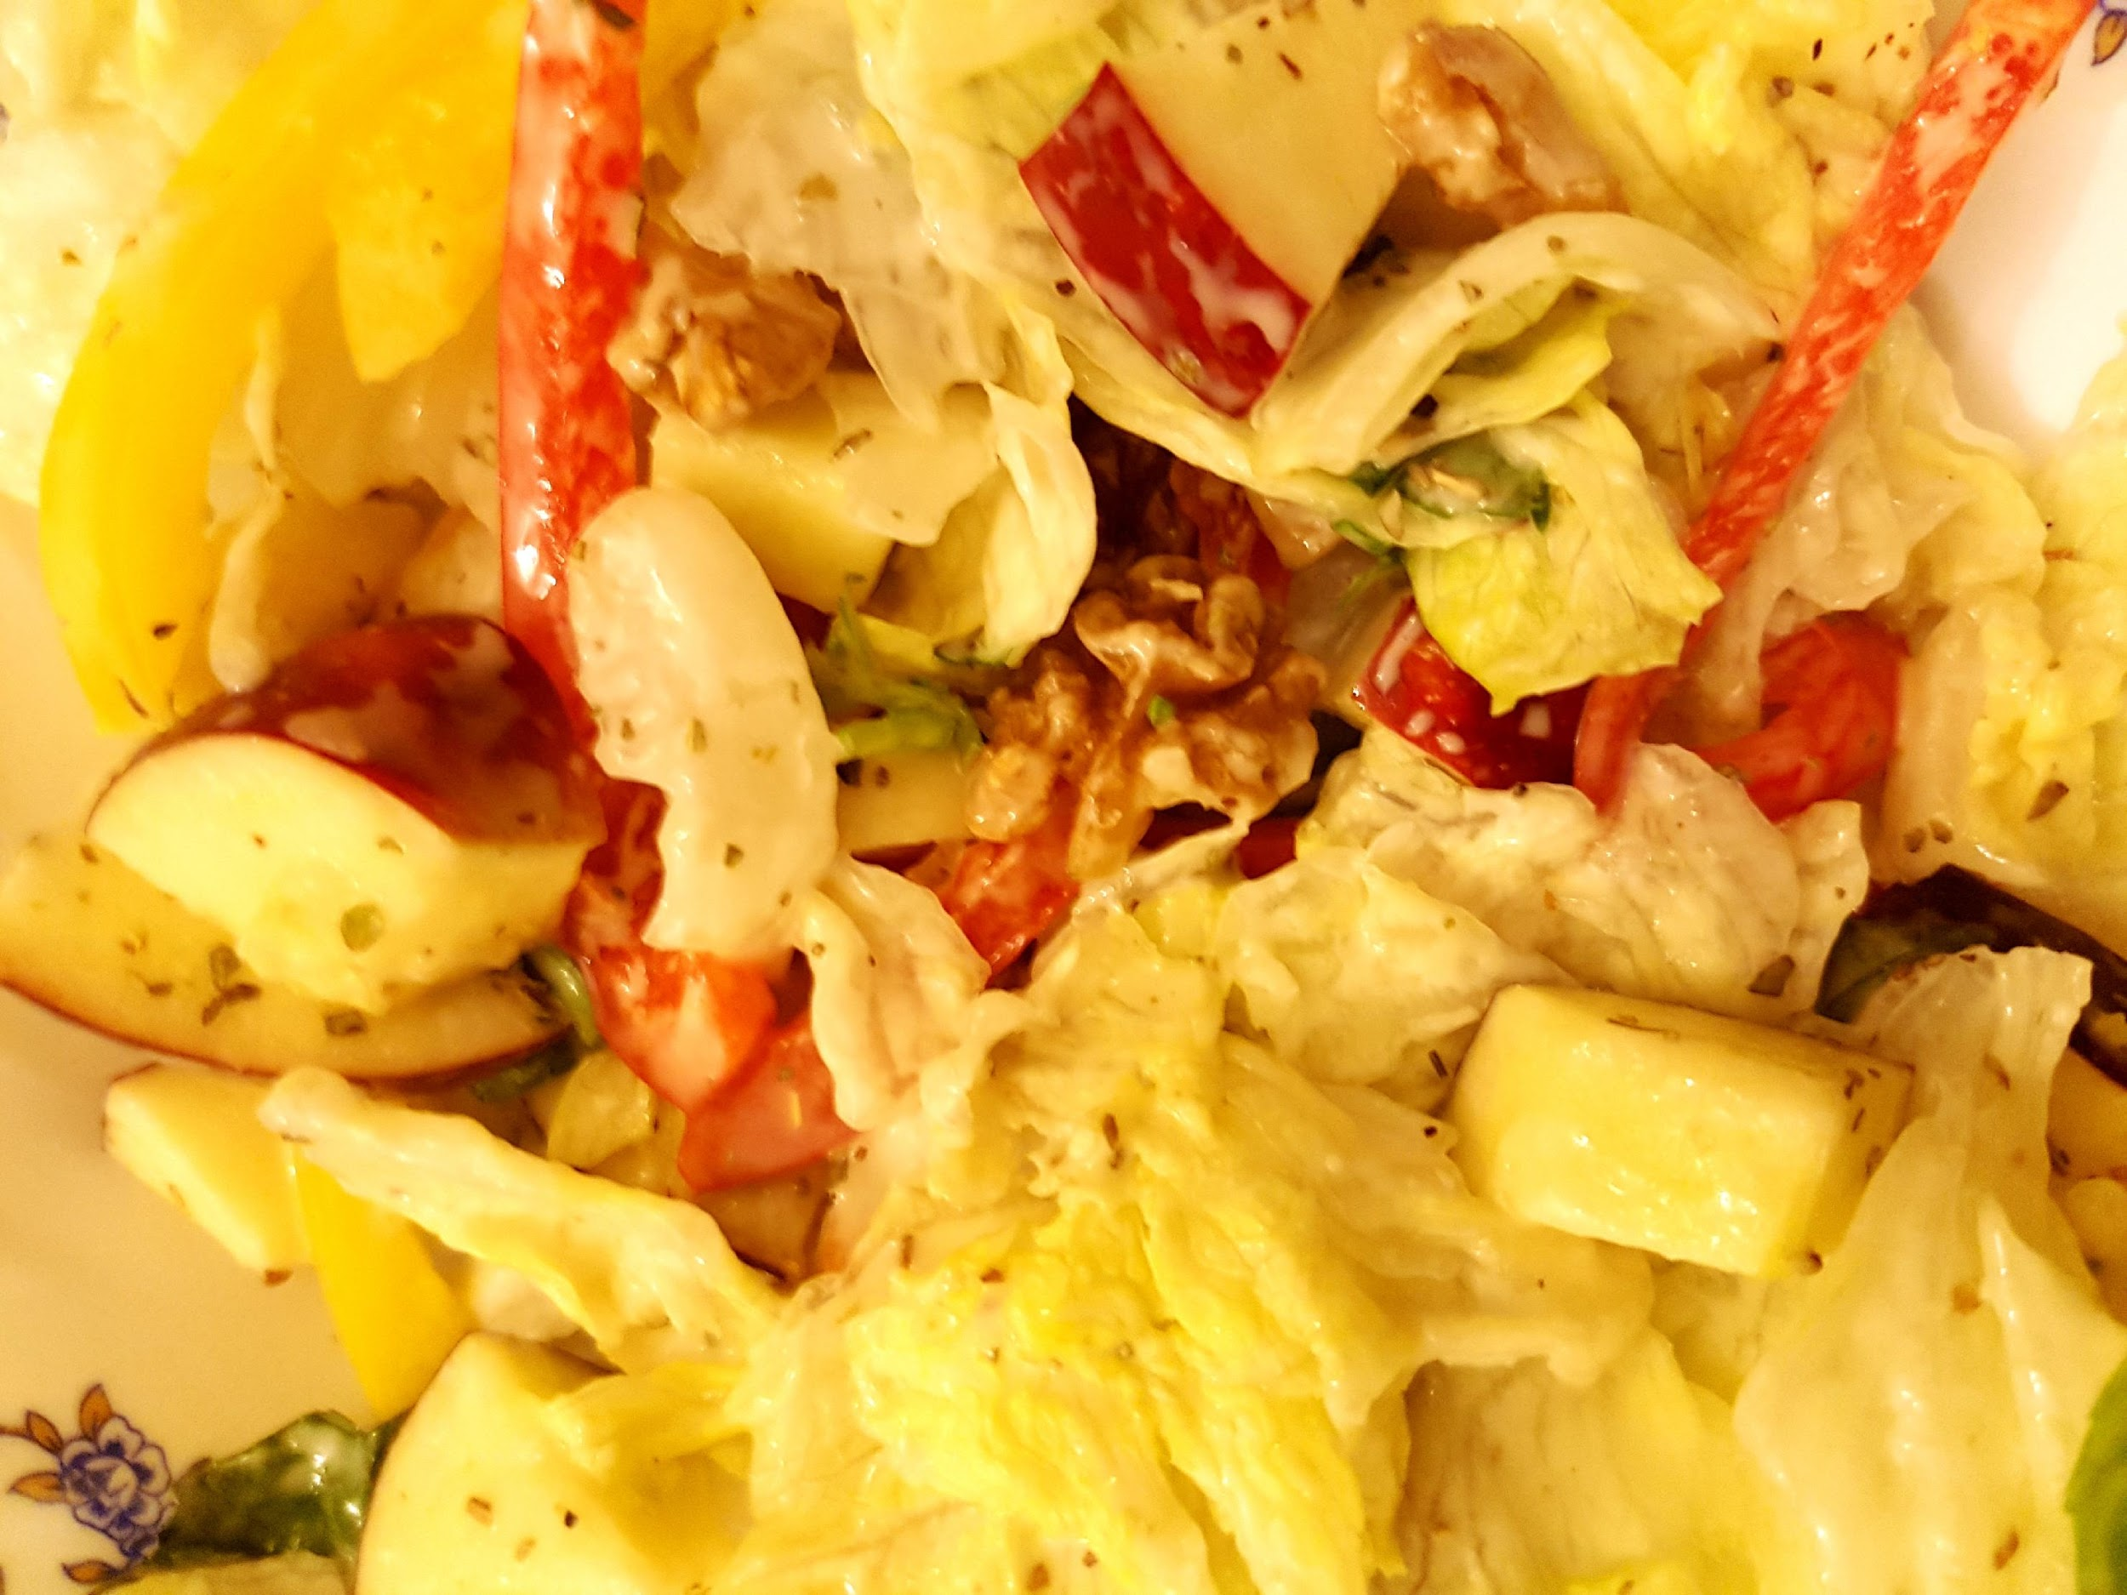
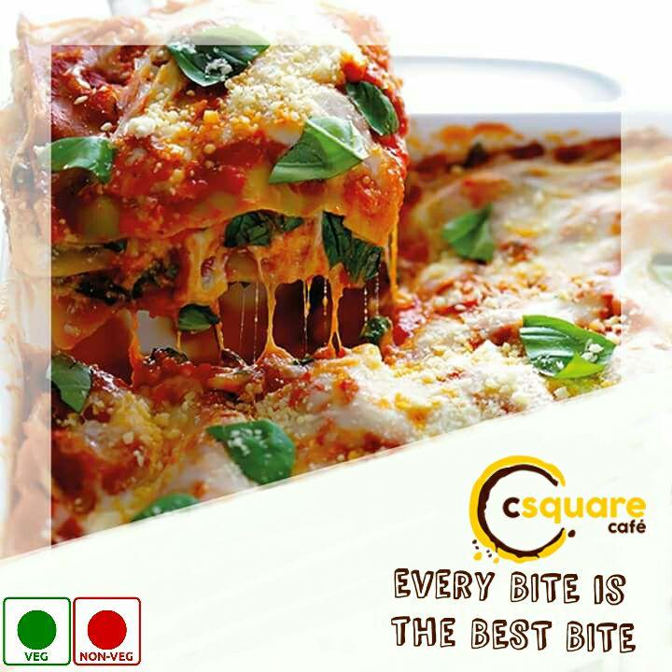
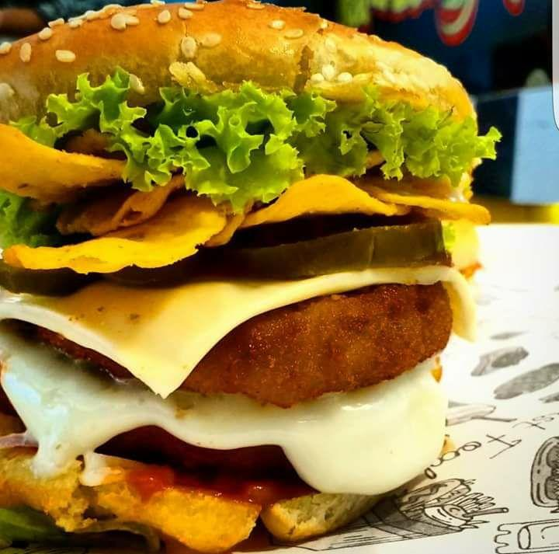
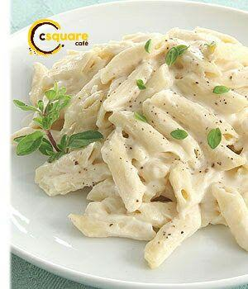
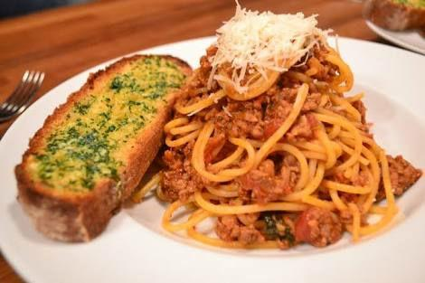
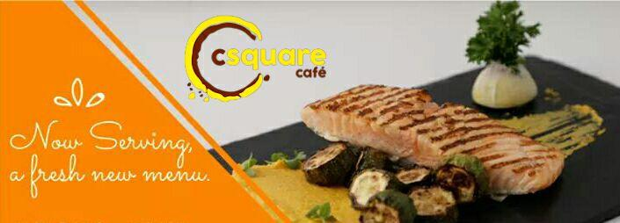
Food shots
Tisane Beverages Pvt. Ltd.

Slide 10
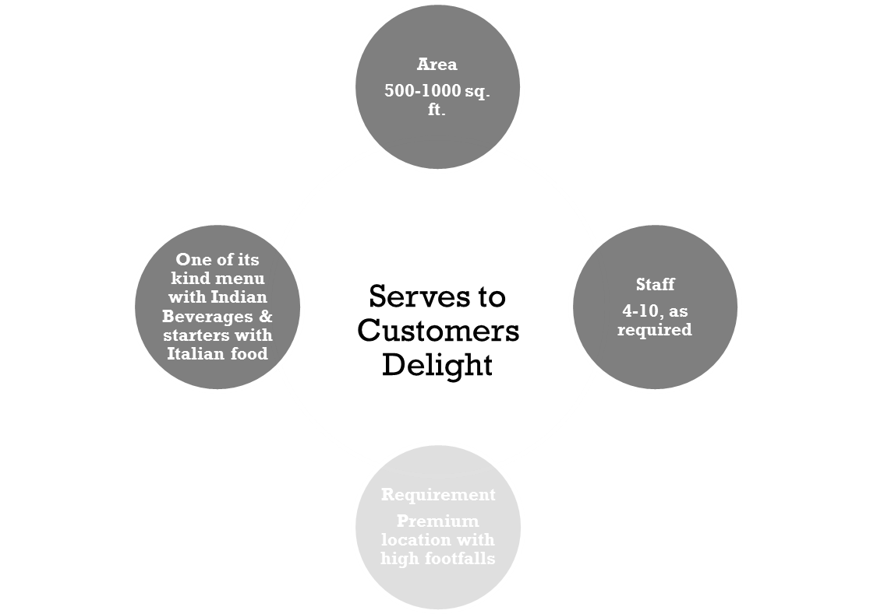
Our Proposal
SP CAFE CSQUARE PVT LTD

Slide 11
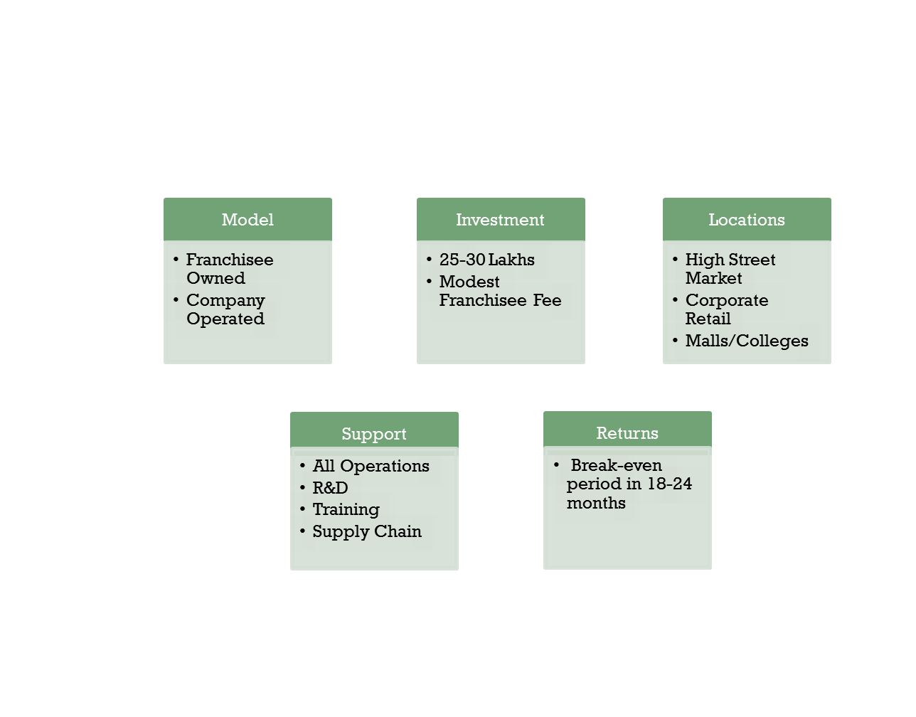

Our Franchisee Model
SP CAFE CSQUARE PVT LTD

Slide 12












Some of our Corporate Clients

Slide 13
Thanks
Our Motto-
Revolutionizing Tea Drinking in India
For further queries please contact
+91 880.004.9122
+91 956.095.9562
www.teahalt.com
Tisane Beverages Pvt. Ltd.

